Slide 1



Coastal Erosion based Assessment of Sagar Island using Satellite Data and AI

Slide 2
Data Collection
LANDSAT 8 30m
ESA LAND USE AND LAND COVER 10m

Slide 3
METHODOLOGY
LANDSAT 8 30m(1990,2000,2010 and 2020)
Digitisation
Cast Transect
Change Rate Calculation using EPR and LRR Model
Prediction of Shoreline for next 10 and 20 years

Slide 4
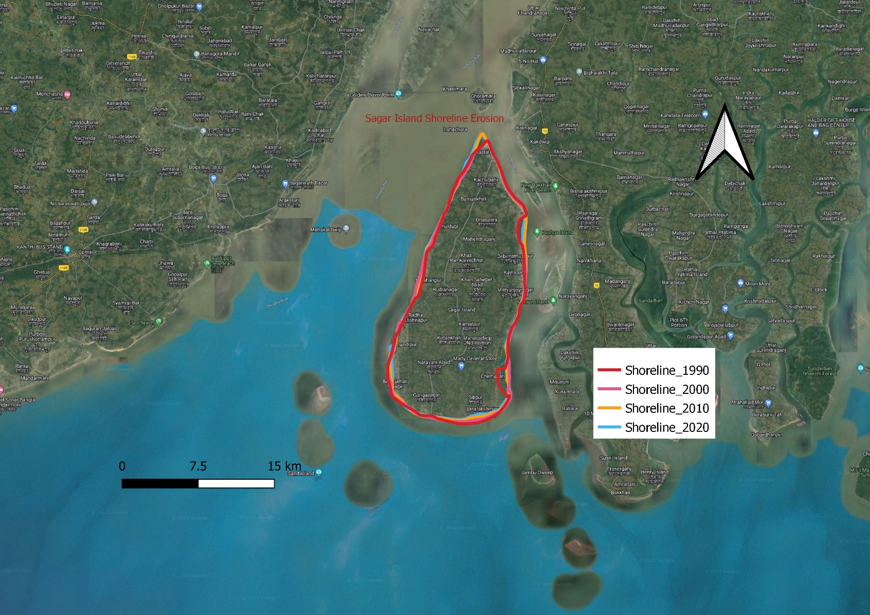
RESULTS AND VISUALISATIONS
Shorelines in Different Years

Slide 5
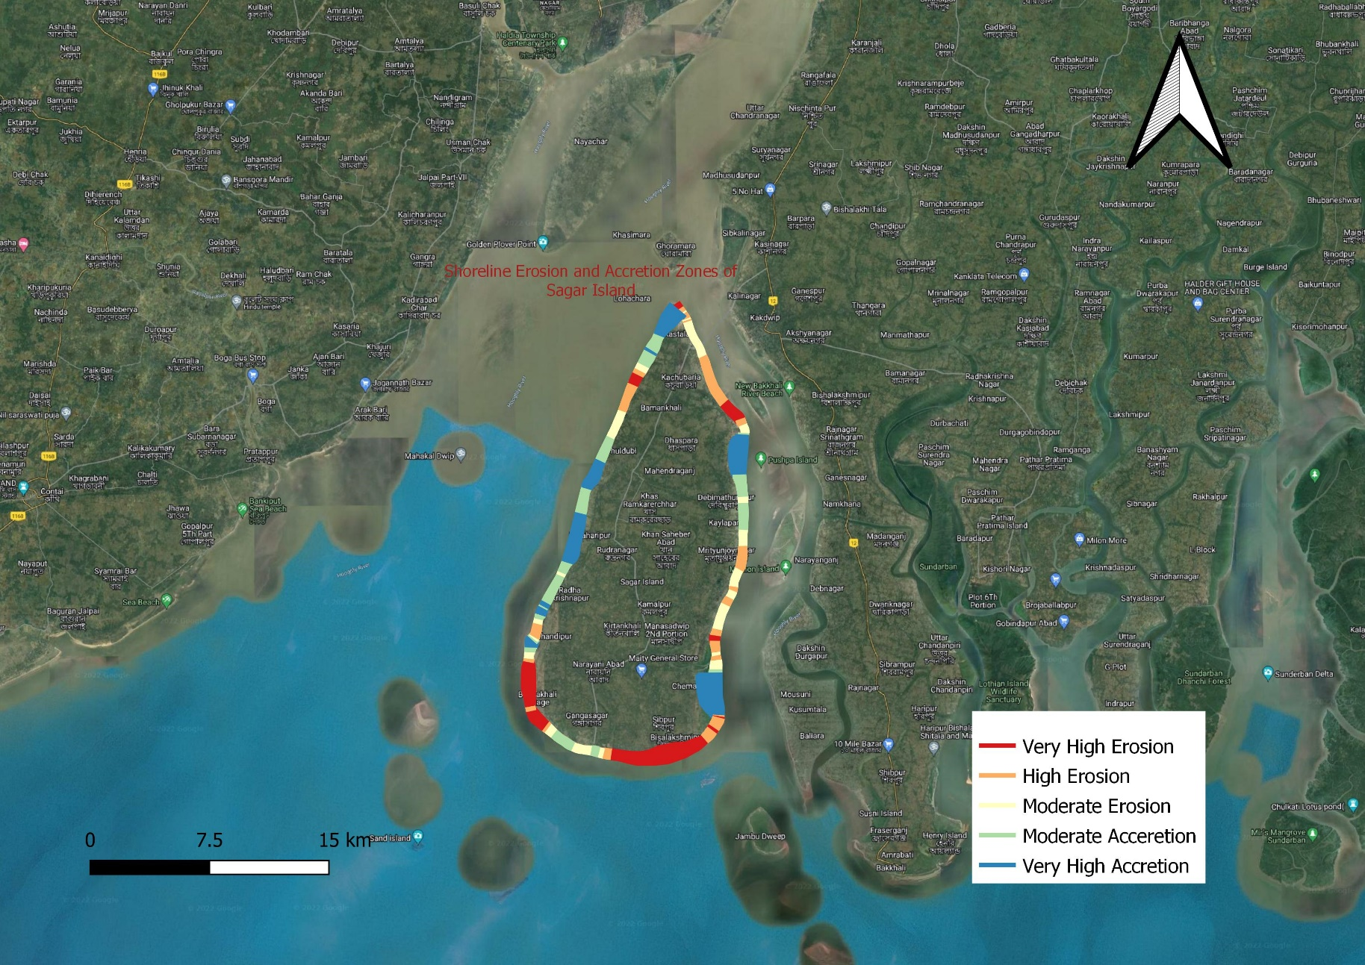
Erosion and Accretion Zones of Sagar Island

Slide 6
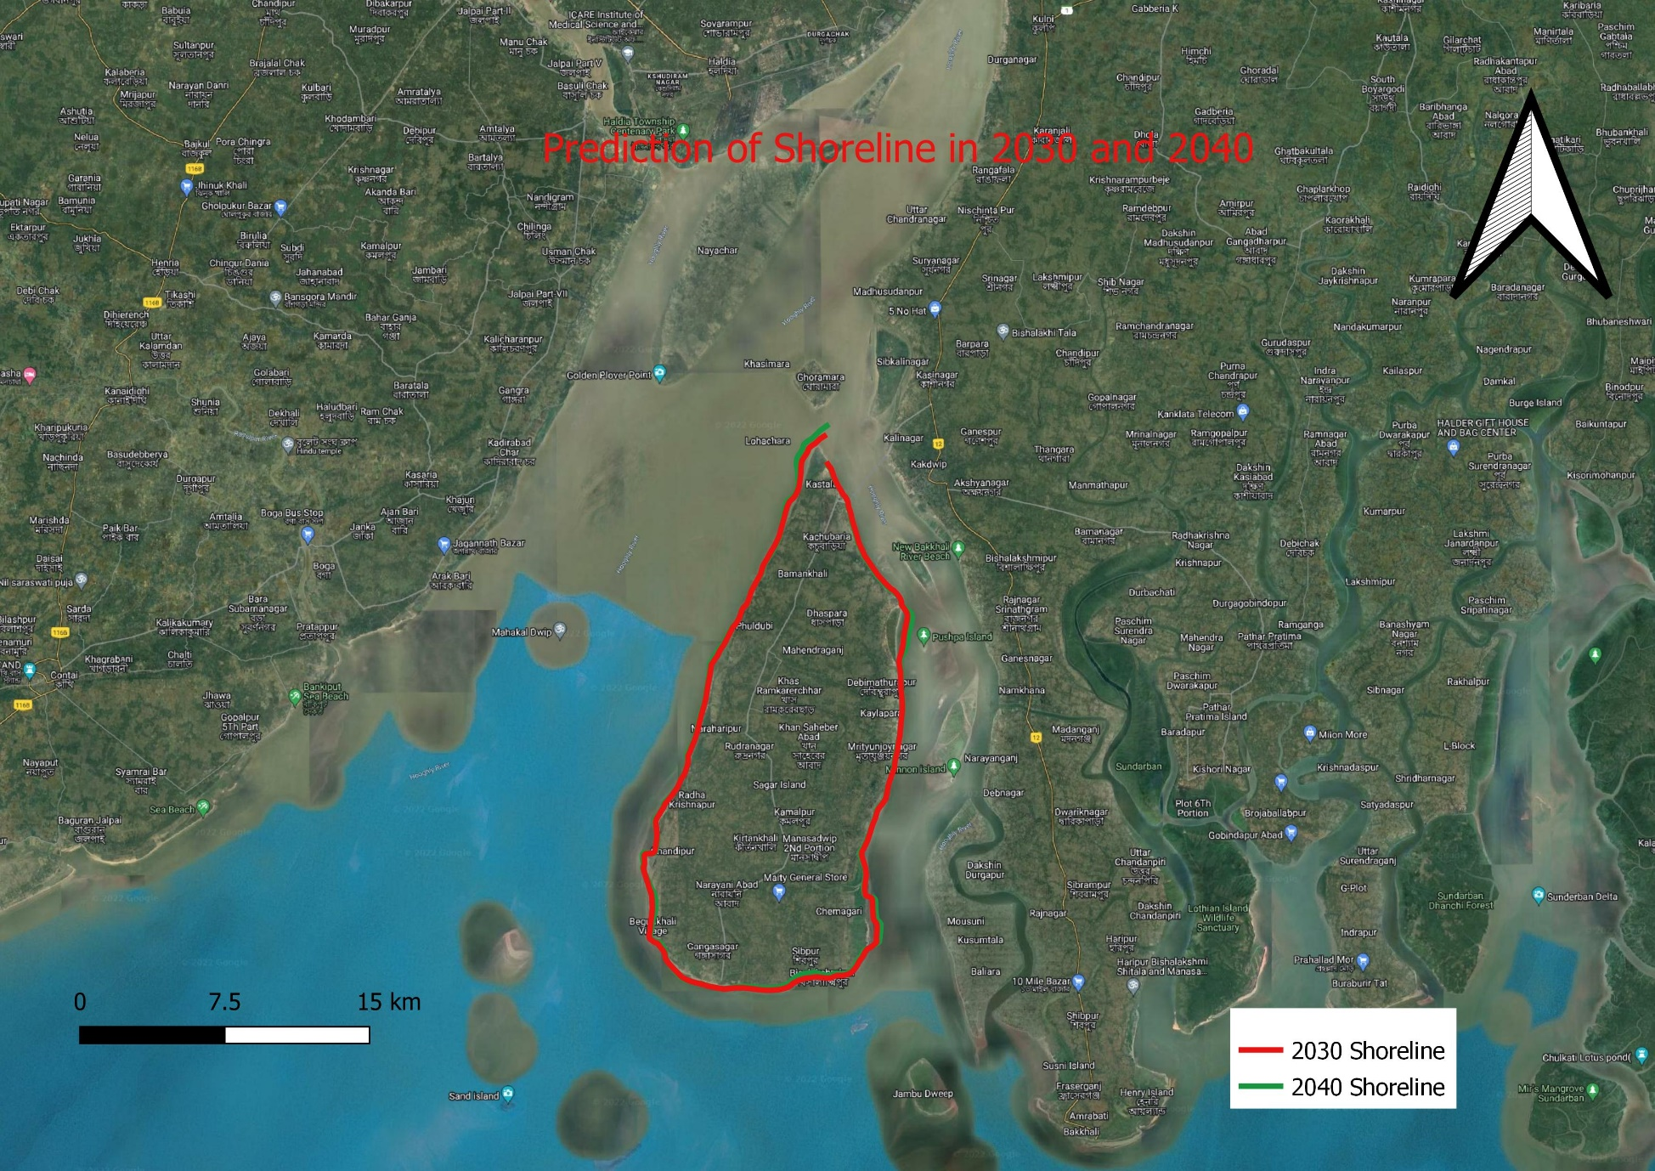
Prediction of Shorelines in 2030 and 2040

